Slide 1

Notes:
we used two softwares one proteus and logicly we have done 8 bit addition subtraction increment and decrement using proteus and multiplication and division using logicly the truth tables we have attached them with a google sheet 🔗 logicly web version link 🔗 for simplicity we didn’t used k maps instead we used truth tables and simplified expressions we used logic toggles as an input Name fetsum abyu ugr/9178/12 kidus wegayehu ugr/0194/12 leulseged G/medhin ugr/5560/12 Image copyright ©️Alamy

Slide 2
Signed 8-Bit Calculator
Adder, Subtracter, Multiplier, Divider, Increment and Decrement

Slide 3
Overview
The calculator built in this project is made to Add, Subtract, Multiply and Divide Two numbers given in their 8-Bit binary representation.
We designed each and every Integrated circuit used in this project using two softwares (Logicly and Proteus).
We designed our own integrated circuits to ease our work and to make the calculator as simple as we can.
First the design of the basic Integrated circuits used will be discussed.

Slide 4
Continued …
The basic integrated circuits used are:
Half Adder
Half Subtractor
Full Adder
Full Subtractor
The above mentioned ICs are used to build the 8 - Bit :
Full Subtractor
Full Adder
Full Multiplier and Divider.

Slide 5
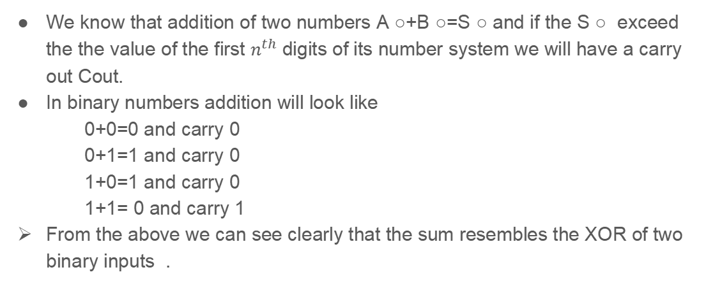
8 bit Binary Adder

Slide 6
Continued….
The carry out resembles the AND of the two inputs .
From the above two we can conclude that :
Sum=A ○ ⊕ B ○
Cout= A ○ B ○
This concept builds up a half adder circuit
In our project we used full adder circuit . As an input we have Cin as a carry input ,A ○ and B ○ where as Sum and Cout as an output.

Slide 7
Continued …
Here below we have the truth table for the full adder
From the truth table we can conclude
Sum=A ○ ⊕ B ○ ⊕Cin
Cout=A ○B ○ + Cin(A ○ ⊕ B ○)
8 bit addition is similar to cascaded 8 single
bit adders with carry out of one input acting
As carry in for the adder which is next to it
Table 1.1 truth table for the
binary bit adder
A○ | B○ | Cin | Sum | Cout
0 | 0 | 0 | 0 | 0
0 | 0 | 1 | 1 | 0
0 | 1 | 0 | 1 | 0
0 | 1 | 1 | 0 | 1
1 | 0 | 0 | 1 | 0
1 | 0 | 1 | 0 | 1
1 | 1 | 0 | 0 | 1
1 | 1 | 1 | 1 | 1

Slide 8
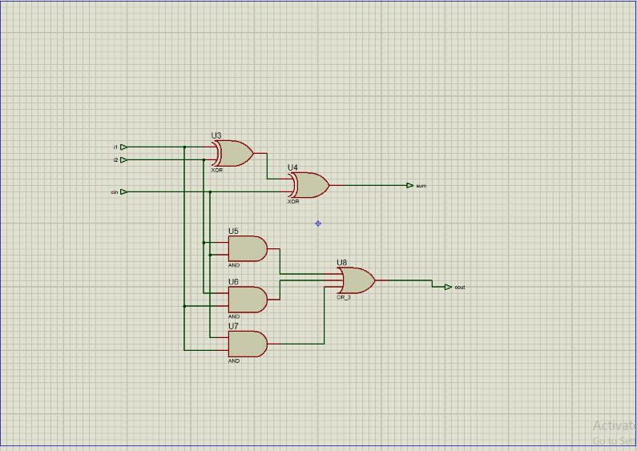
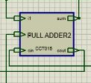
Continued …
We have implemented the full adder using XOR and AND gates that the connection shown below represents the Full adder sub circuit and its inside in proteus
Fig 1.1 sub circuit model Fig 1.2 inside of the sub circuit

Slide 9
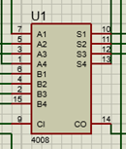
Continued …
In previous slides we have seen that the implementation of addition of single bits , since we made 8 bit adder we found it neat and simple to use 74LS183 IC chips
74LS183 is an IC chip package which performs the addition of four bits for our project we used two of this chips
Fig 1.3 74LS183 in proteus

Slide 10
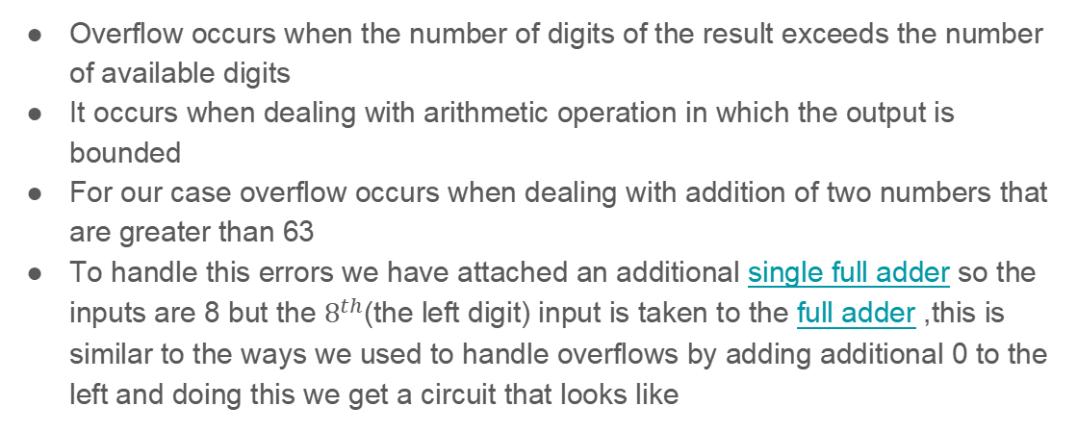
Handling overflow for the addition

Slide 11
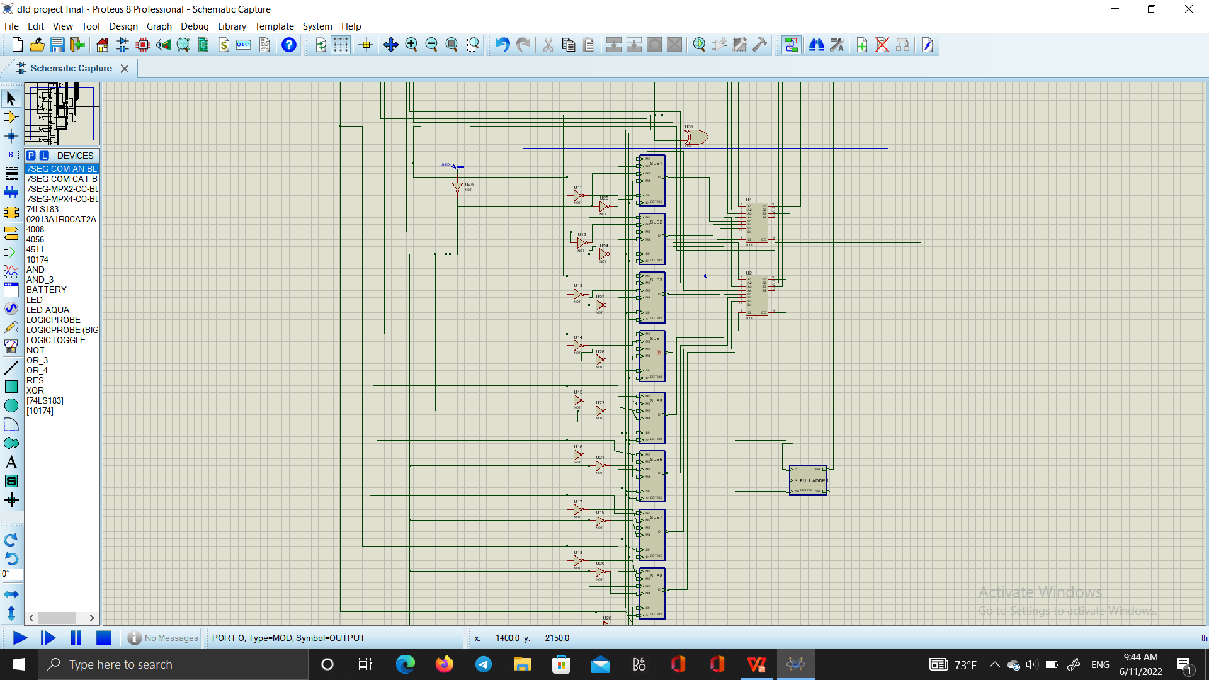
Continued…
Fig 1.5 bit adder for handling overflow
Fig 1.4 adder circuit with additional 1 bit adder

Slide 12
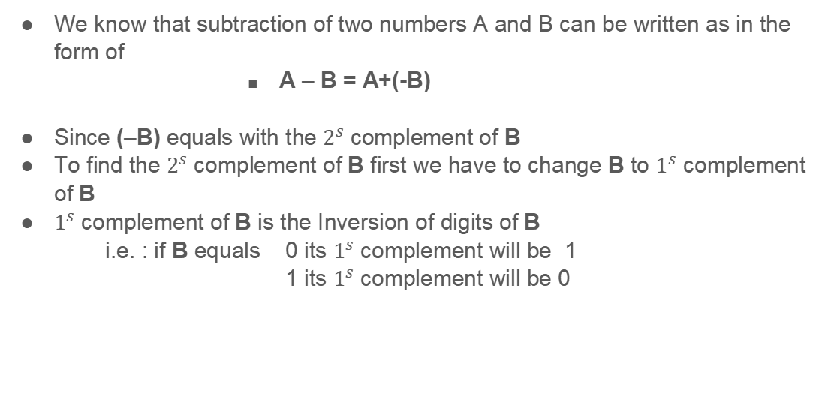
8 bit Binary Subtractor

Slide 13
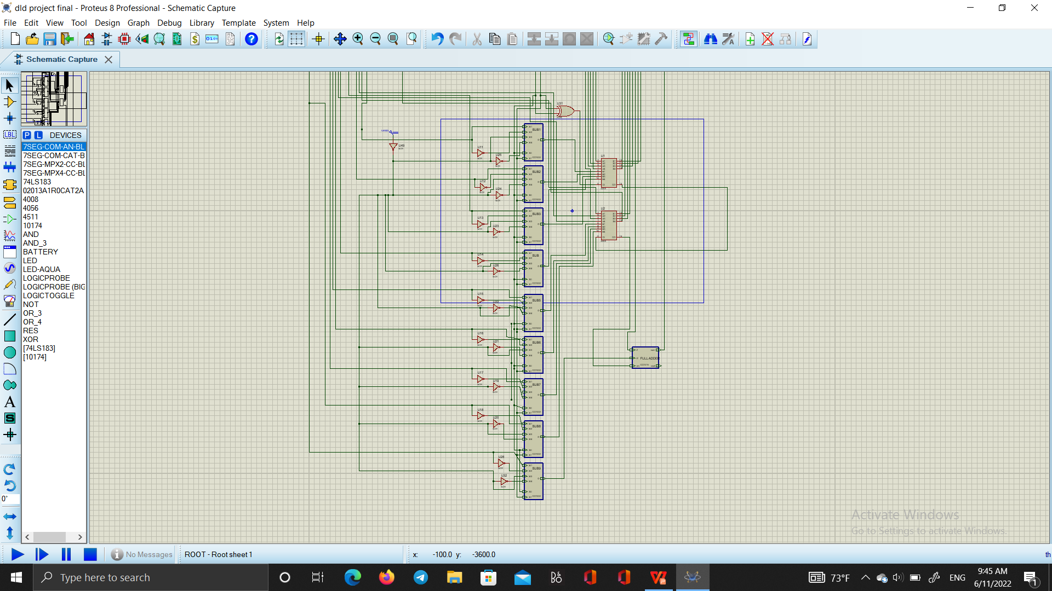
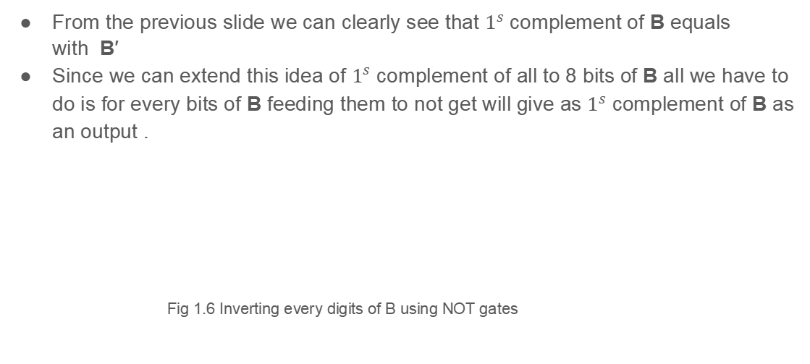
Continued…

Slide 14
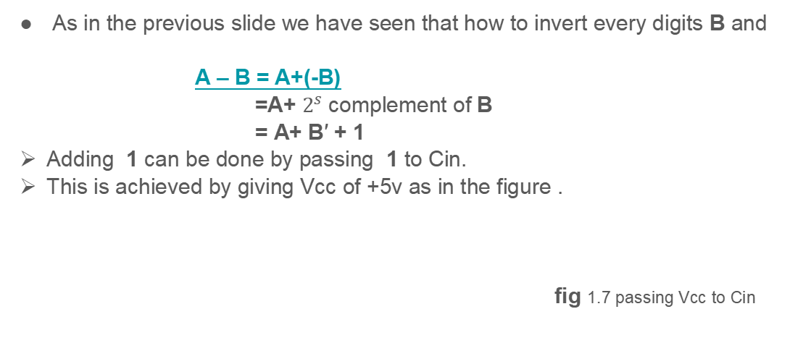
Continued…

Slide 15
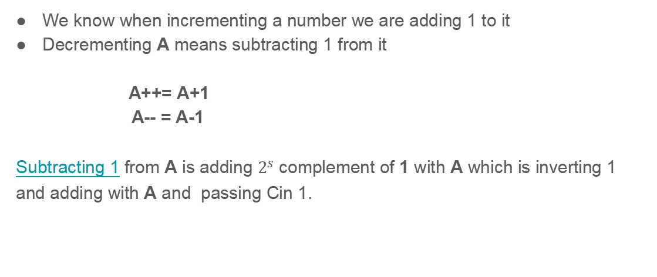
Increment and Decrement

Slide 16
Selecting type of Operations
To achieve selection of operations we used a multiplexer circuit thus we have to select from 4 operations i.e addition, subtraction ,increment and decrement
S0 | S1 | M1 | M2 | M3 | M4 | OUTPUT
0 | 0 | 0 | D | D | D | 0
0 | 0 | 1 | D | D | D | 1
0 | 1 | D | 0 | D | D | 0
0 | 1 | D | 1 | D | D | 1
1 | 0 | D | D | 0 | D | 0
1 | 0 | D | D | 1 | D | 1
1 | 1 | D | D | D | 0 | 0
1 | 1 | D | D | D | 1 | 1

Slide 17
Continued…
Simplifying the truth table using sum of product we get
output = S0 ′ S1 ′ M1 + S0 ′ S1 M2 + S0 S1 ′ M3 + S0 S1 M4 implementing this using AND,OR and NOT gates and not gates we get the circuit
since the MUXs that proteus has some malfunction we used a MUX sub
Circuit hat we ourselves build

Slide 18
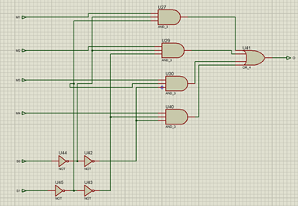
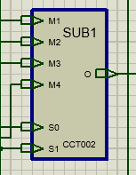
Continued…
Fig 1.8 inside of sub circuit Fig 1.9 multiplexer sub circuit

Slide 19
Continued…
For selectors S0 and S1
S0 S1 output
0 0 B add
0 1 B ′ subtract
1 0 0 increment
1 1 1 decrement
Since this is the outside function of multiplexer we gave B to M1 , B ′ to M2, 0 for M3 and 1 for M4
We have one 4x1 MUX For each digits i.e for the 8 bits there are 8 MUXs and for the additional overflow handling bit we have 1 additional 4x1 MUX

Slide 20

Continued…
For Cin to be 1 when S0=1 S1=0 and S0=0 and S1=1 and 0 for the rest which this statement is XOR equivalent of S0 and S1 which the output is given to Cin and this condition is implemented
Fig 1.10 the implementation of the above statement in our project

Slide 21
The Multiplier
From elementary math we know that Multiplication in nothing but repeated addition.
In 2 bit multiplication:
1*0 = 0
0*0 = 0
0*1 = 0
1*1 = 1
When we see the properties of multiplication it looks just like the results of AND gate.
From the above points we observe that multiplication of binary numbers A and B is done by multiplying each binary digit of A with each binary digit of B and add all the partial products obtained using full adders.

Slide 22
Continued …
The multiplication is done using AND gates.
That is A○ & B○ = A○*B○
Then each result is added using full adders.
This circuit could also be designed by generating the truth table and then solve the k-map though it might take much work.
Here is the link to Truth Table for 8-BIT MULTIPLIER we made where False signifies the logic 0(LOW) and True signifies the logic !(HIGH).

Slide 23
THE 8-BIT DIVIDER
we know that division is repeated subtraction thus for number A to be devided by number B the result is it should be the number of steps that it takes to get to B.
thus for counting the number of steps we can use cascaded full and half adders or counters to count the steps for our project we done the division using cascaded full and half adders.
the truth table for the 8 bit Binary divider you can find it via the google sheet link that embeded in this text.

Slide 24
Manipulating the output of Adder circuits
we used the output digit from the adder as input to the circuit that enables us to change negative number to thier positive equivalent.
we used XOR gates and full adders for each digit to implement this action i.e it takes all the digits and if the left most digit after the arithmetic operation is 0 it takes the output it self but if it is 1 the ciruit changes it to the positive equivalent by making its 2’s complement and lightens on the negative indicator diode .
Since we get positive digits as an output the BCD to 7 segment decoder decodes it.

Slide 25
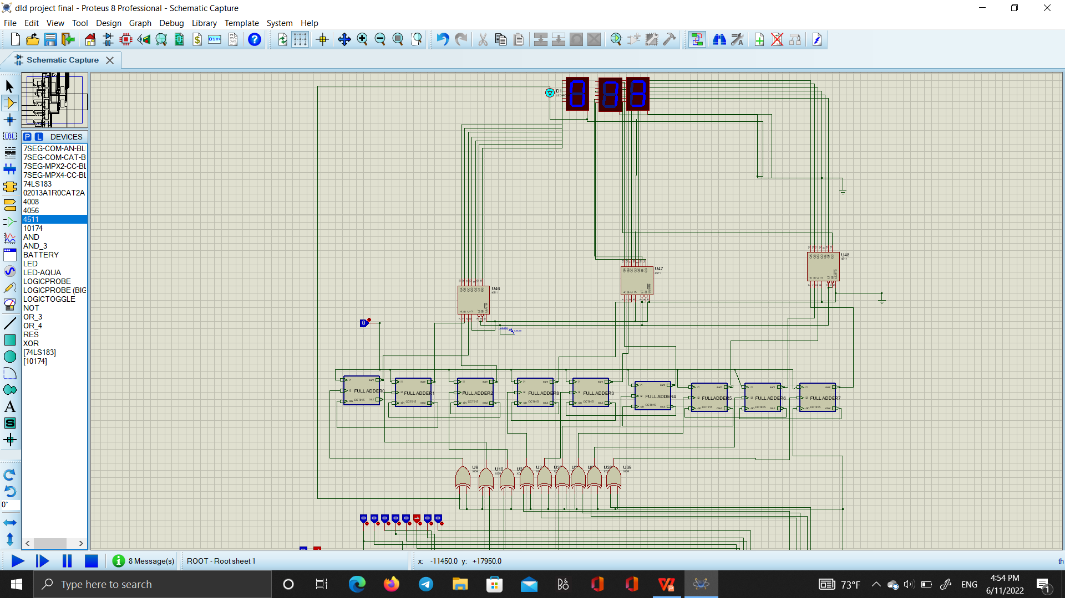
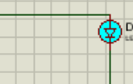
Continued...
LED is zoomed in for displaying
fig 1.10 changing the negative output from the adders to thier correspnding to positive and the LED connection

Slide 26
BCD to 7 Segment display
We used three 7 segment displays for the project made with proteus and for the project which is made with Logicly.
Each segment is connected to 4 bit binary to 7 segment decoder an IC 4511 is used to do the decoding
decoding 8 bit numbers with IC 4511 has some shortcomings such as it won’t work properly for the numbers greater than 9 thus designing our own sub circuit was necessary.
On our way to design an 8 bit to 7 segment display decoders we have encounted problems like the truth table implementation needs 256 input variables and 21 output segments since implementing this using KMap will introduce extra dimension work. leaving this we have made a Binary to Octal converter using 3 BCD to decimal decoders that takes its three inputs are from the manipulated output and the left is given 0 this method works well for displaying octals.

Slide 27
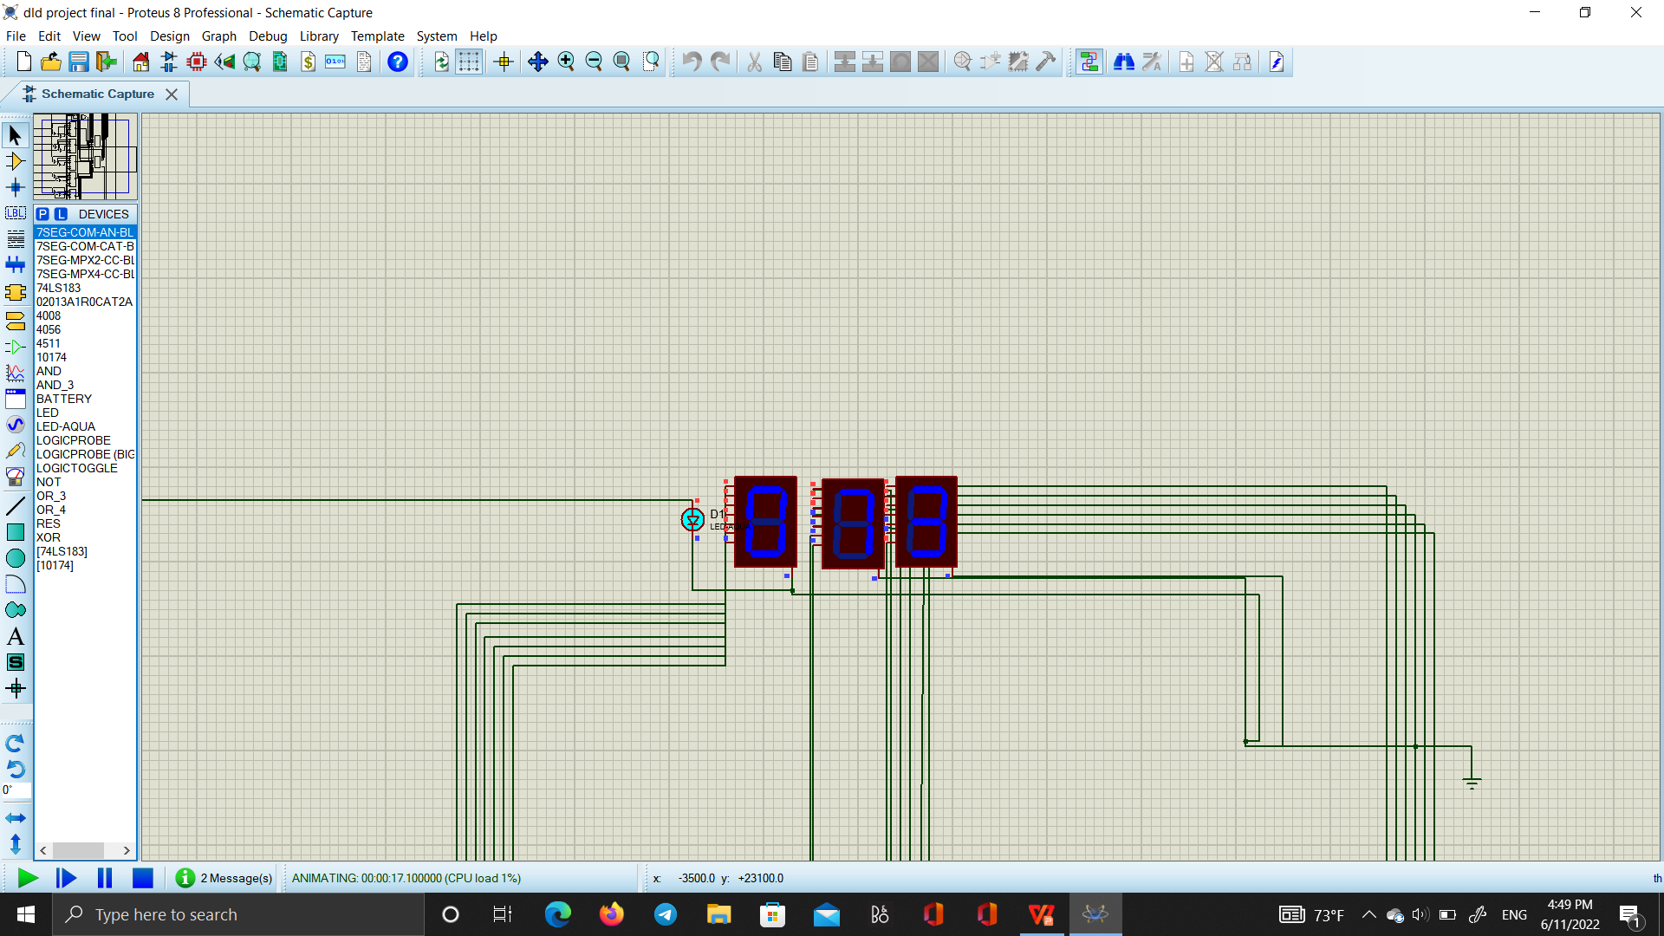
continued...
Fig 1.10 circuit that does 2’s complement Fig 1.11 three 7 segment displays and negative indicator diode

